Slide 1

The Unified Process
Inception
Notes:
‹#›

Slide 2
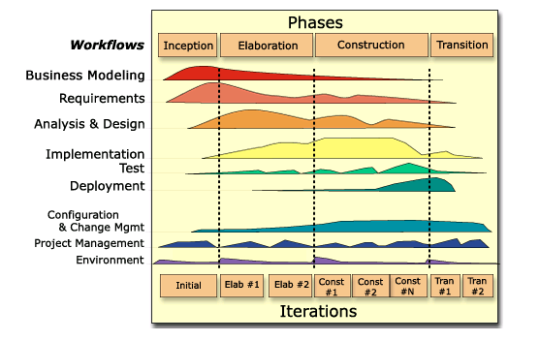
(Rational) Unified Process (R)UP

Slide 3
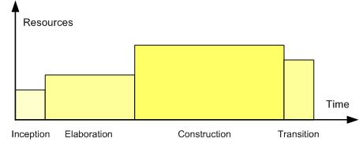
Iterative Development and RUP
Inception
Elaboration
Construction
Transition
Preliminary
Iteration
Architect
Iteration
Architect
Iteration
Developer
Iteration
Developer
Iteration
Developer
Iteration
Transition
Iteration
Transition
Iteration
Inception: Understand what to build
Vision, high-level requirements, business case
Not detailed requirements
Elaboration: Understand how to build it
Baseline architecture, most requirements detailed
Not detailed design
Construction: Build the product
Working product, system test complete
Transition: Validate solution
Stakeholder acceptance
An iteration is a distinct sequence of activities with an established plan and evaluation criteria, resulting in an executable release.

Slide 4
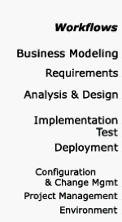

Inception: Know What to Build
Step 1: Prepare vision document and initial business case
Include risk assessment and resource estimate
Step 2: Develop “high-level” project requirements
Initial scenarios and domain models (10-20% complete)
Step 3: Manage project scope
Reduce risk by identifying all key requirements
Acknowledge that requirements will change
Manage change, use iterative process
Inception
Elaboration
Construction
Transition

Slide 5
Specific Objectives with Inception
1. Understand what to build
Vision: who wants the system, it’s value (to both customers and the business), and it’s scope
Deliverable: Vision document, Initial Use Case Catalog
2. Identify key requirements
Critical use cases and non-functional requirements
Deliverable: Refine initial Use Case catalog with priorities
3. Determine at least one potential solution
Identify candidate architecture
Deliverable: Prototypes to evaluate feasibility
4. Understand costs, schedule and risk
Business case, Software Development Plan, & Risk List
RUP had document templates for these, others (such as IEEE) exist
5. Understand what process to follow and tools to use
RUP configuration, development case, and customized tools
Deliverable: Software Development Plan, initial environment/tools setup

Slide 6

Objective 1: Understand What to Build
Provide a “mile-wide, inch-deep” description
Identify as many actors (stakeholders) as you can
Associate each of the actors with usage scenarios
For each scenario, find any additional actors
Briefly describe each actor (1-2 sentences) & scenario (1-2 par)
Create a Glossary and/or Business Domain Model
Identify most essential & critical scenarios (<20% of all scenarios)
Detail key actors and usage scenarios
Done for 10-20% most critical scenarios
Outline main flow of events
Complement textual descriptions with examples or prototypes
Time-box the writing, you never get “done”
Use less detail
Fundamental - Scope!!!

Slide 7
Objective 2: Identify Key System Funcitonality
Functionality is the core of the application
Exercises key interfaces
Deals with risks related to performance, redundancy, data security, …
Example: “Check Out” for e-commerce application
Functionality must be delivered
Captures the essence of the system
Example: “Book conference room” for conference room booking system
Functionality covers an otherwise untouched area of the system
May conceal unexpected technical difficulties
Depth, Breadth, and Priority

Slide 8

Common Pitfalls in Inception
Too much formality / too many artifacts
Only produce the artifacts that add value, minimize formality if possible
When in doubt of value, don’t do it
Analysis Paralysis
You can improve upon things later on – move on
Focus on objectives with Inception
Do NOT describe all requirements in detail
Get feedback! Get the “Yes, buts” out of the way
Too long initial iteration
Cut scope rapidly
If you fail with first iteration, your project is likely to fail

